Slide 1
COMP 309 - Data Warehousing and Data Mining in HCIS
Name: Peter Bhola
Reading week : Week starting 22nd of October

Slide 2
Evaluation Scheme
Test # 1: Worth 25% course grade
Test # 2: Worth 25% of course grade
Assignments:
Assignment 1: 10 marks Due 4th Week
Assignment 2: 10 marks Due 8th Week
Assignment 3: 10 marks Due 11th Week
Assignment 4: 10 marks Due 14th Week
Assignments will be assessed in the lab, on the date they are due. 20% will be deducted if it not available for assessment and another 20% if it is not available the following week.
Quizzes: There will be two quizzes each worth 5%.
Bonus will be given for attendance and class participation
Cannot make up for missed quizzes or tests.

Slide 3
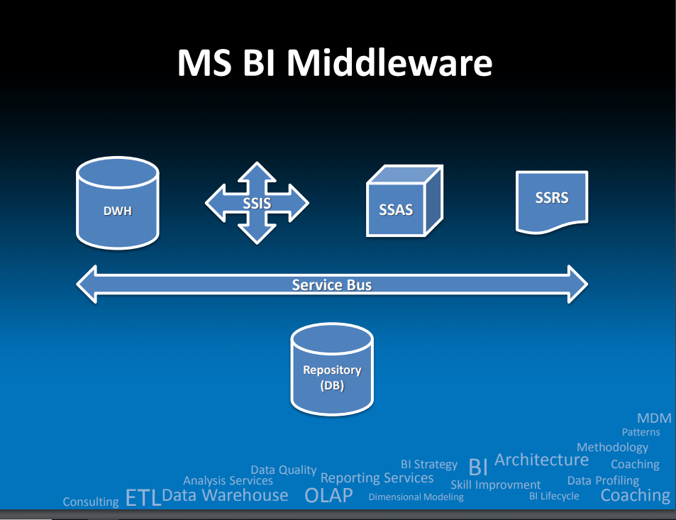
Assignments will be done using MS BI middleware

Slide 4
Optional but Recommended
Providing your computer has the memory.
Install SQL Server 2016 Enterprise. Download from the HUB or Kivuto
Install SSAS, SSAS ( in memory), SSIS, SSRS
Install the BI add-on on VS2017.

